Slide 1
Green Stormwater Infrastructure: Managing Surrounding Landscapes
Prepared by : Emma Melvin, PHS
Notes:
Welcome to this Green Infrastructure Maintenance Training. This presentation is one of several in the training series. You can view the entire series sequentially, or each module independently.

Slide 2
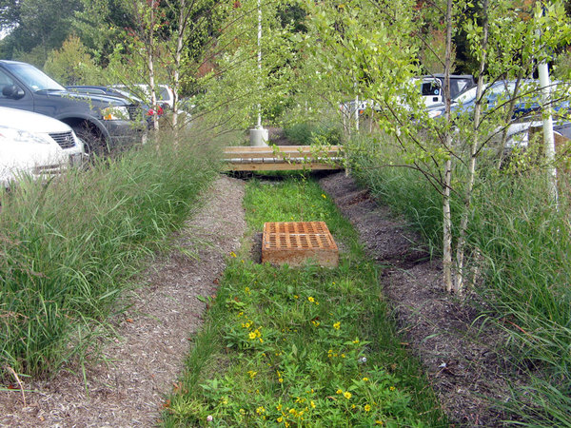
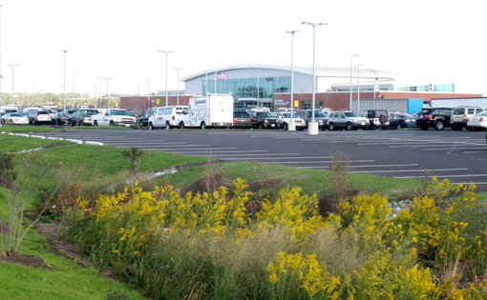
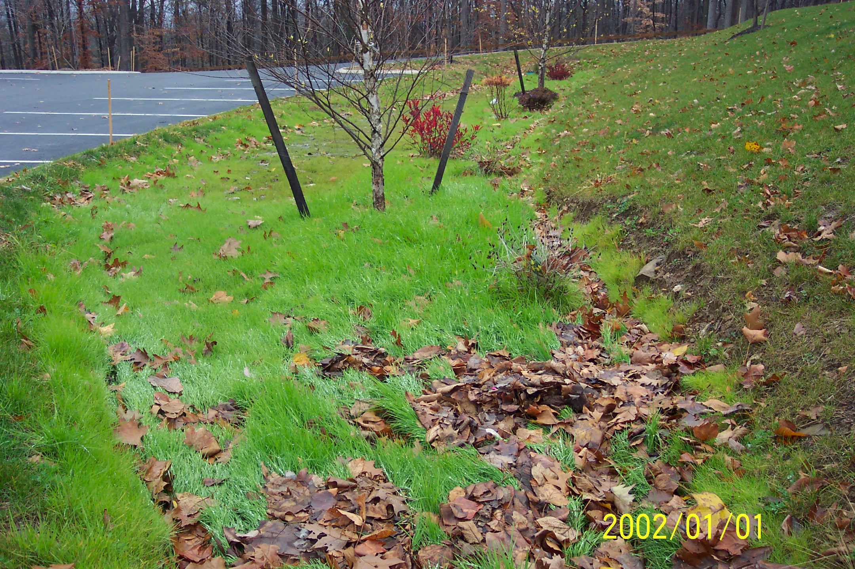
Overview
How can the surrounding land areas influence the structure and function of Green Infrastructure systems
What maintenance measures should be undertaken to ensure consistent functioning
Notes:
Careless maintenance in the landscape adjacent to Green Stormwater Management Practices can affect proper functioning.
In this presentation you will learn:
How the surrounding land areas can influence the structure and function of Green Infrastructure systems
What maintenance measures should be undertaken to ensure consistent functioning

Slide 3
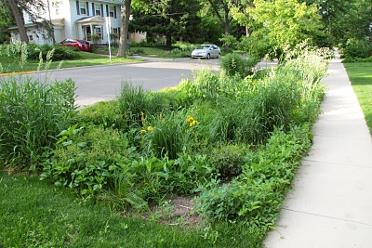
Managing for Function & Aesthetics
Notes:
When managing bio-retention systems, it is important to consider how to manage the landscape surrounding the system as well as the interior of the system.
Remember: function will always outweigh aesthetics. It is a priority that these systems are highly functioning with good plant cover to ensure that deep roots will help drain water from the planting bed.
Issues that need to be considered include the following:
*Plants naturally die back, and new ones will always grow in the open spaces in the landscape -- including weeds and invasive plants arriving from outside the planting bed.
*Any products such as pesticides or herbicides placed on turf or other plants outside the system will be carried into the bio-retention system along with the stormwater.
*Different landscaping crews may manage different parts of the landscape, and their objectives and techniques need to coordinate.
Decisions need to be made by the maintenance crews about management inside and outside the system in order to sustain a healthy and functioning system.

Slide 4
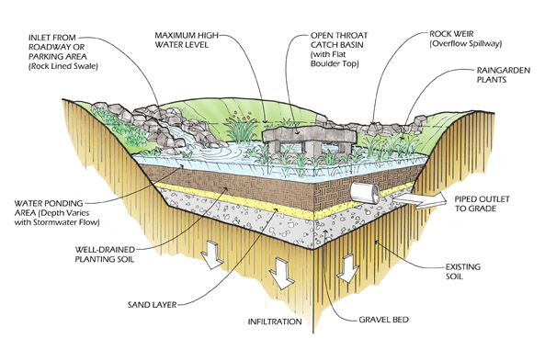
Bioretention Systems
Notes:
Over time, a functioning bio-retention system or rain garden can be compromised if not routinely maintained.

Slide 5
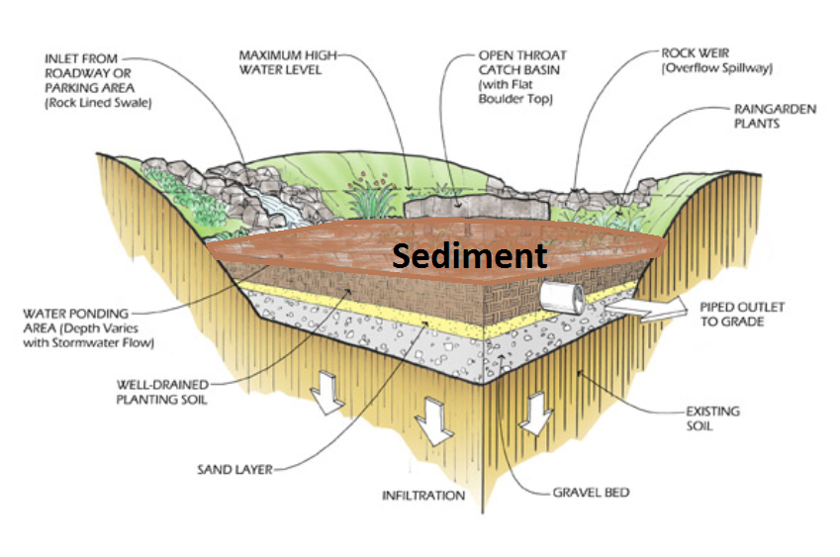
Bioretention Systems
Notes:
Erosion from a poorly designed or malfunctioning system, or from destabilized soil areas outside the system can settle as sediment in the ponding area of the rain garden. The sediment can form a hard packed surface that won’t allow water to penetrate. Plants cannot survive in this soil and may die.

Slide 6
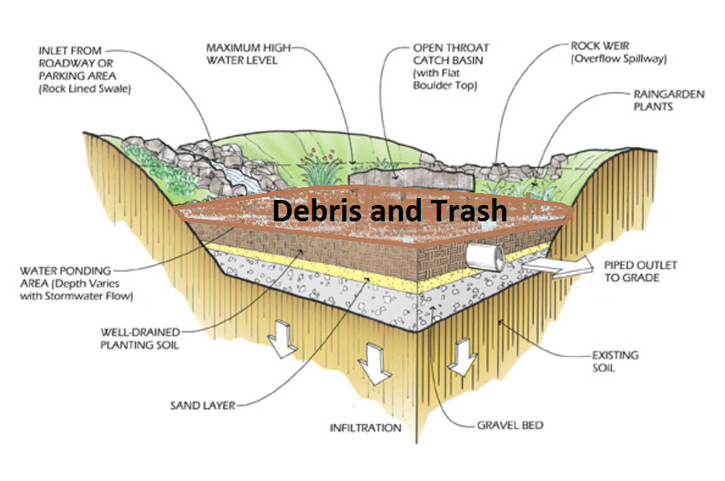
Bioretention Systems
Notes:
Debris and trash may also collect in the ponding area, blocking infiltration and proper outflow of water.

Slide 7
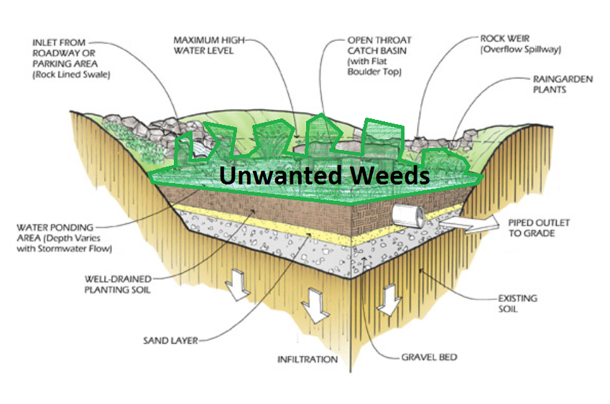
Bioretention Systems
Notes:
Weed and invasive plant seeds can be transported into the bio-retention system by stormwater and animals, from landscape beds, turf or woodlands around the site. Weeds should be managed in the surrounding landscape so as to reduce the seed bank that can spread into the bio-retention system. Depending on the location of these systems, management practices will vary. For systems located in a highly visible area where aesthetics are a priority, management of weeds in the surrounding landscape may require more intense maintenance than for ones in a natural landscape within a park.
We will be talking about ways to minimize the impacts of lawn and garden management on these bio-retention systems.

Slide 8
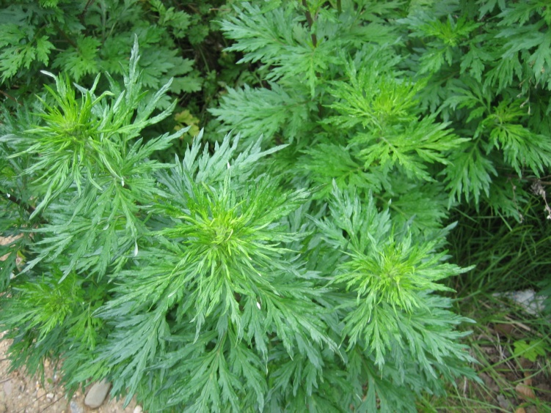
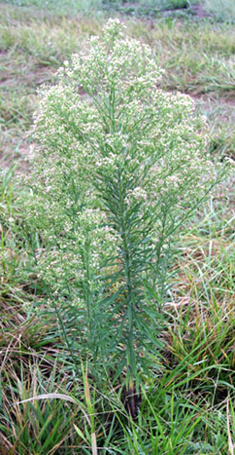
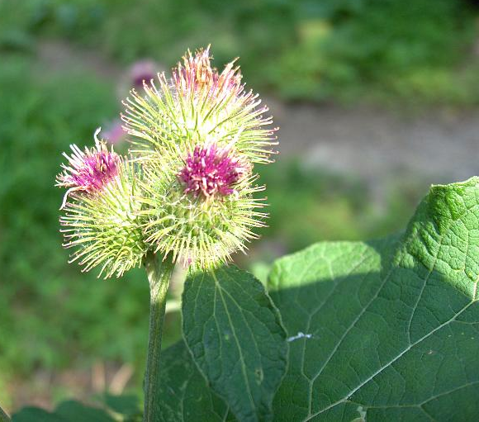
Weed Plant
Not planted by the gardener
Not valued where it is growing
Of vigorous growth that tends to overgrow or choke out more desirable plants.
Ex. Dandelions, crab grass and plantain in a garden
Notes:
Weeds are plants that are not in the “right” or planned location, i.e. which were not planted by the gardener. They are generally not valued where they are growing and are usually of vigorous growth. Especially problematic are invasive plants (whether native or exotic) that tend to overgrow or choke out more desirable plants. These should be managed to achieve whatever appearance the owner is hoping to achieve. In a gateway or highly visible location, weeds in and outside the system should be removed to reduce the spread of the seeds into the bio-retention system.

Slide 9
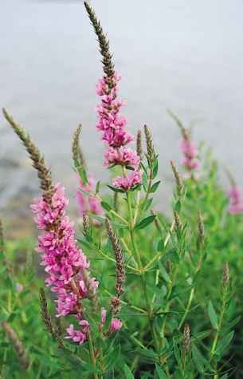
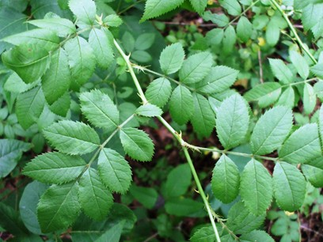
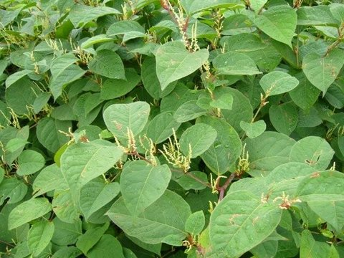
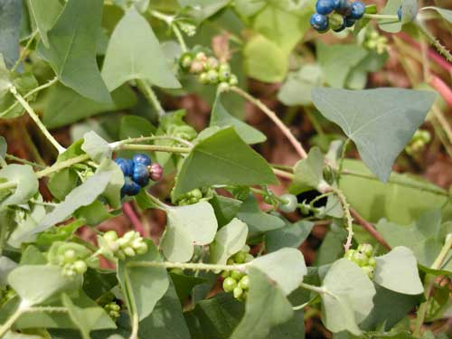
Non-Native Invasive Plants
Non-native plants that have an adverse impact on habitats or eco-regions where they are introduced.
Notes:
Non-native invasive plants are plants that are from foreign locations and which have an adverse impact on the habitats or eco-regions they are introduced to. Ecological impacts include:
Disturbing a habitat by dominating and outcompeting native plants for their spot or role in the habitat;
Providing little to no benefit to the native animals/plants within the habitat or eco-region; and
Altering the components of the habitat, including the soils and the presence of native animals/plants within the habitat.
Generally native plants require less attention than non-native ones, since they are adapted to their environment.
Landscapes near bio-retention systems should be monitored for invasive plants that could be introduced into the systems, in addition to spreading to other natural systems such as streams and rivers and woodlands.

Slide 10
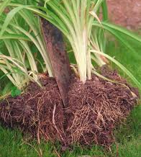
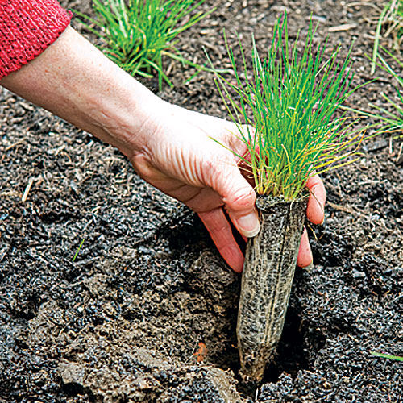
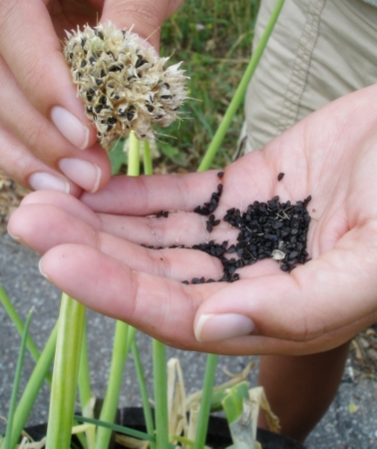
Filling Out the Planting Bed
Cultivate soil to reduce compaction
Divide thriving plants
Remove weeds and dead plants
Add plant plugs
Replant divided plants
Collect seeds &
disperse throughout
garden
Prune only broken or damaged branches
Notes:
Keeping the bio-retention area full of thriving plants will reduce the impact of weed and invasive plant seeds entering the garden. If plants die back in some areas, replant. Bare areas give weeds and invasive plants an opportunity to invade the planting bed. When conducting maintenance on a site:
assess the health of all plants,
divide any plants that are thriving and spreading, and use them to fill in areas where plants have died
weed out any unwanted plants and
remove any dead plants.
If the system is new, with small plants that are not ready to be divided, add small plants -- called plugs -- to fill in any open areas.
In the fall, collect the seeds of desirable plants and disperse them throughout the garden to ensure the spread of these plants. Prune only dead or damaged stems or branches. Trees and shrubs should be pruned for proper structure only in the dormant period.

Slide 11
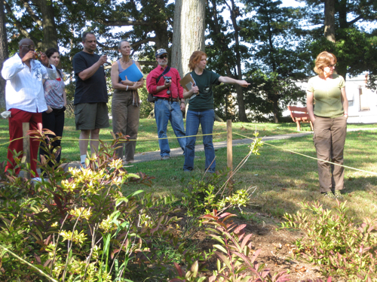
Working Outside the System
Delineating bioretention area from turf
Notes:
When bio-retention systems are managed by a different person or landscape company than the surrounding landscape, it is important to delineate the perimeter of the functioning garden..
The system can be marked as simply as wooden posts with string.

Slide 12
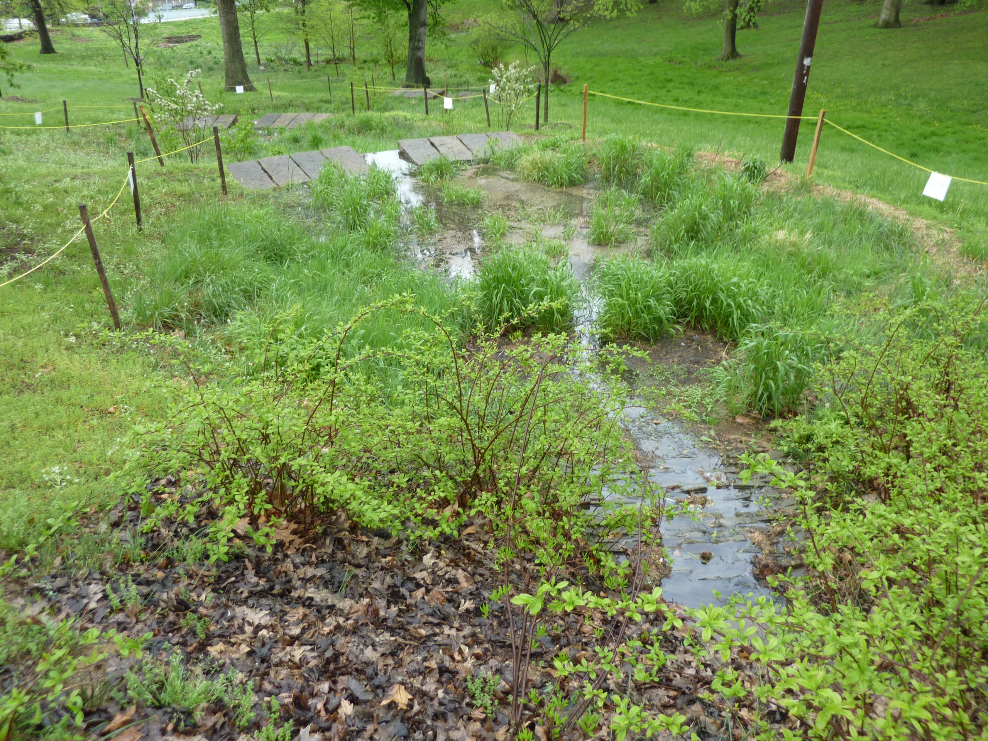
Working Outside the System
Delineating bioretention area from turf
Notes:
Marking the perimeter of the system is especially critical in systems with a minor depression that contain perennial grasses and with turf as the adjacent land cover, because it may be hard to differentiate the types of grasses.

Slide 13
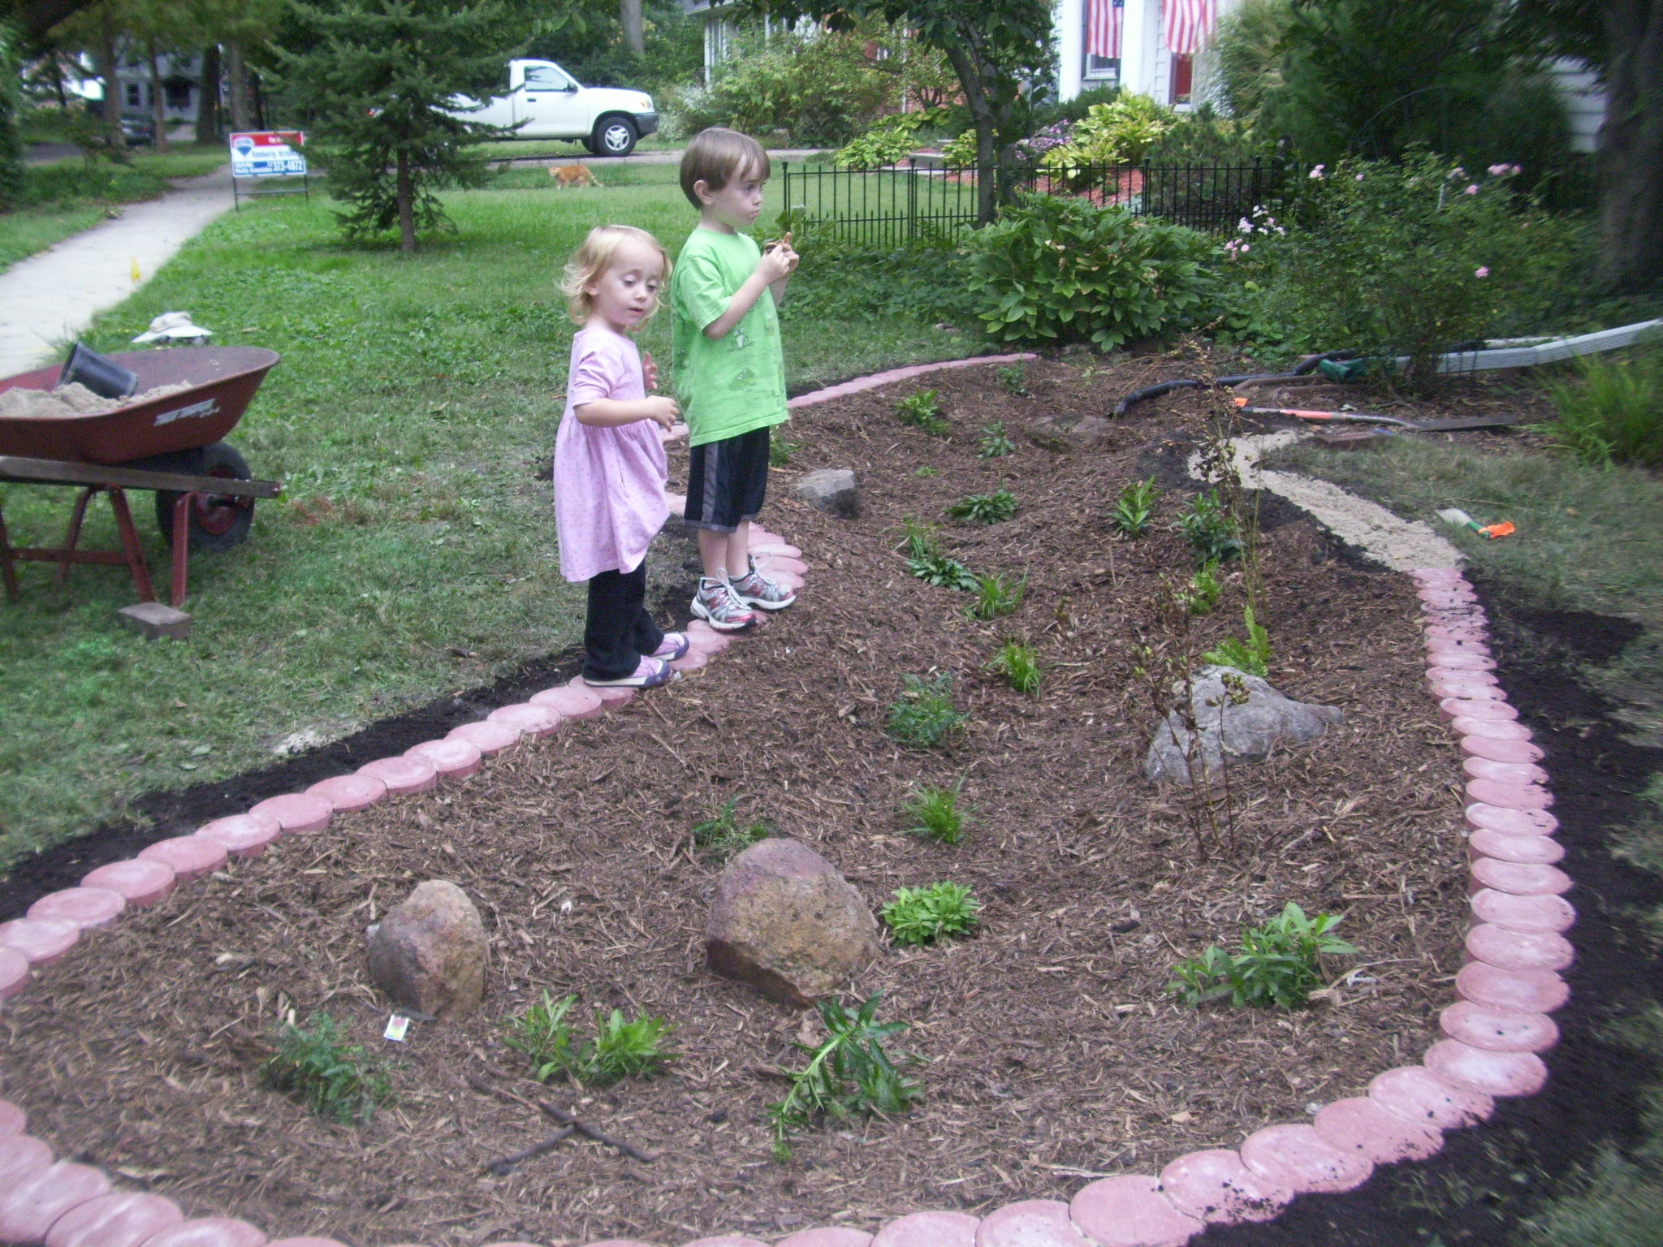
Working Outside the System
Delineating bioretention area from turf
Notes:
Physically indicating the boundary of the bio-retention system is important during the growing season as well as in the fall to avoid mowing issues and to ensure that any management activities are not creating a barrier to the water flow into the garden

Slide 14
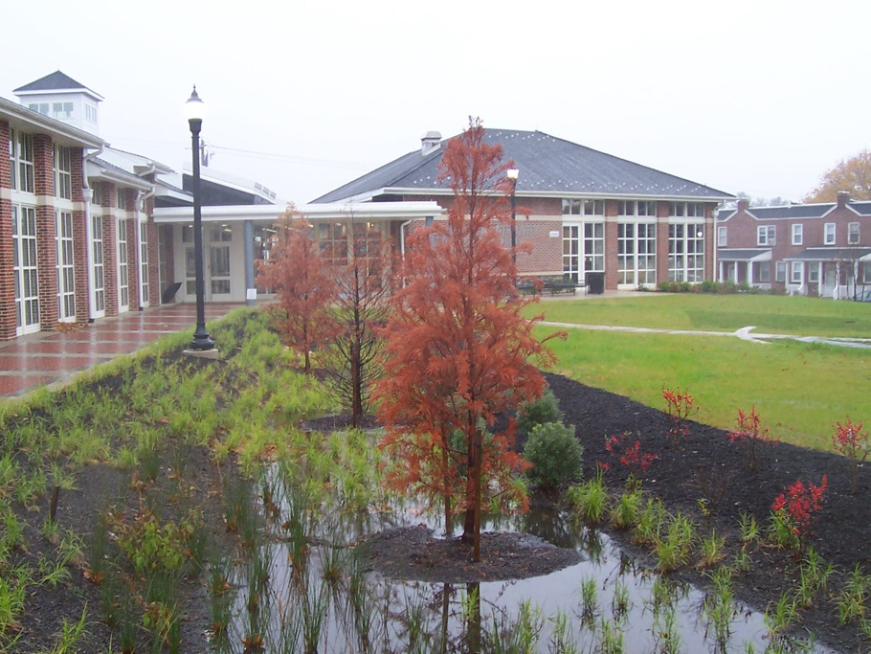
Working Outside the System
Delineating bioretention area from turf
Notes:
To ensure long-term success, it’s important to avoid creating challenges for those responsible for mowing.

Slide 15
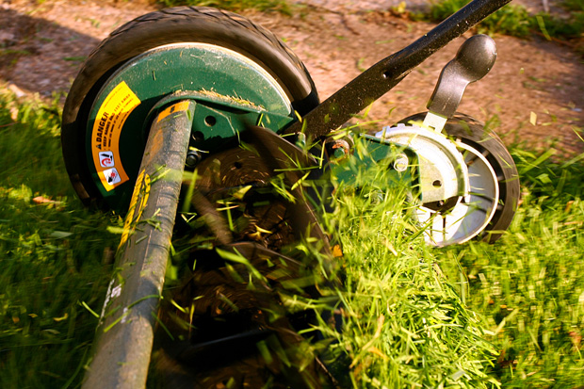
Working Outside the System
Turf management
Notes:
When mowing, ensure that all the grass clippings are left on the lawn and not sprayed into the rain garden, where they may clog the system as they decompose.

Slide 16
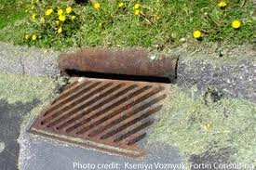
Working Outside the System
Turf management
Notes:
When cleaning walkways, always collect clippings and either place them back onto the lawn or into the garbage. Do not allow them to collect near inlet structures.

Slide 17
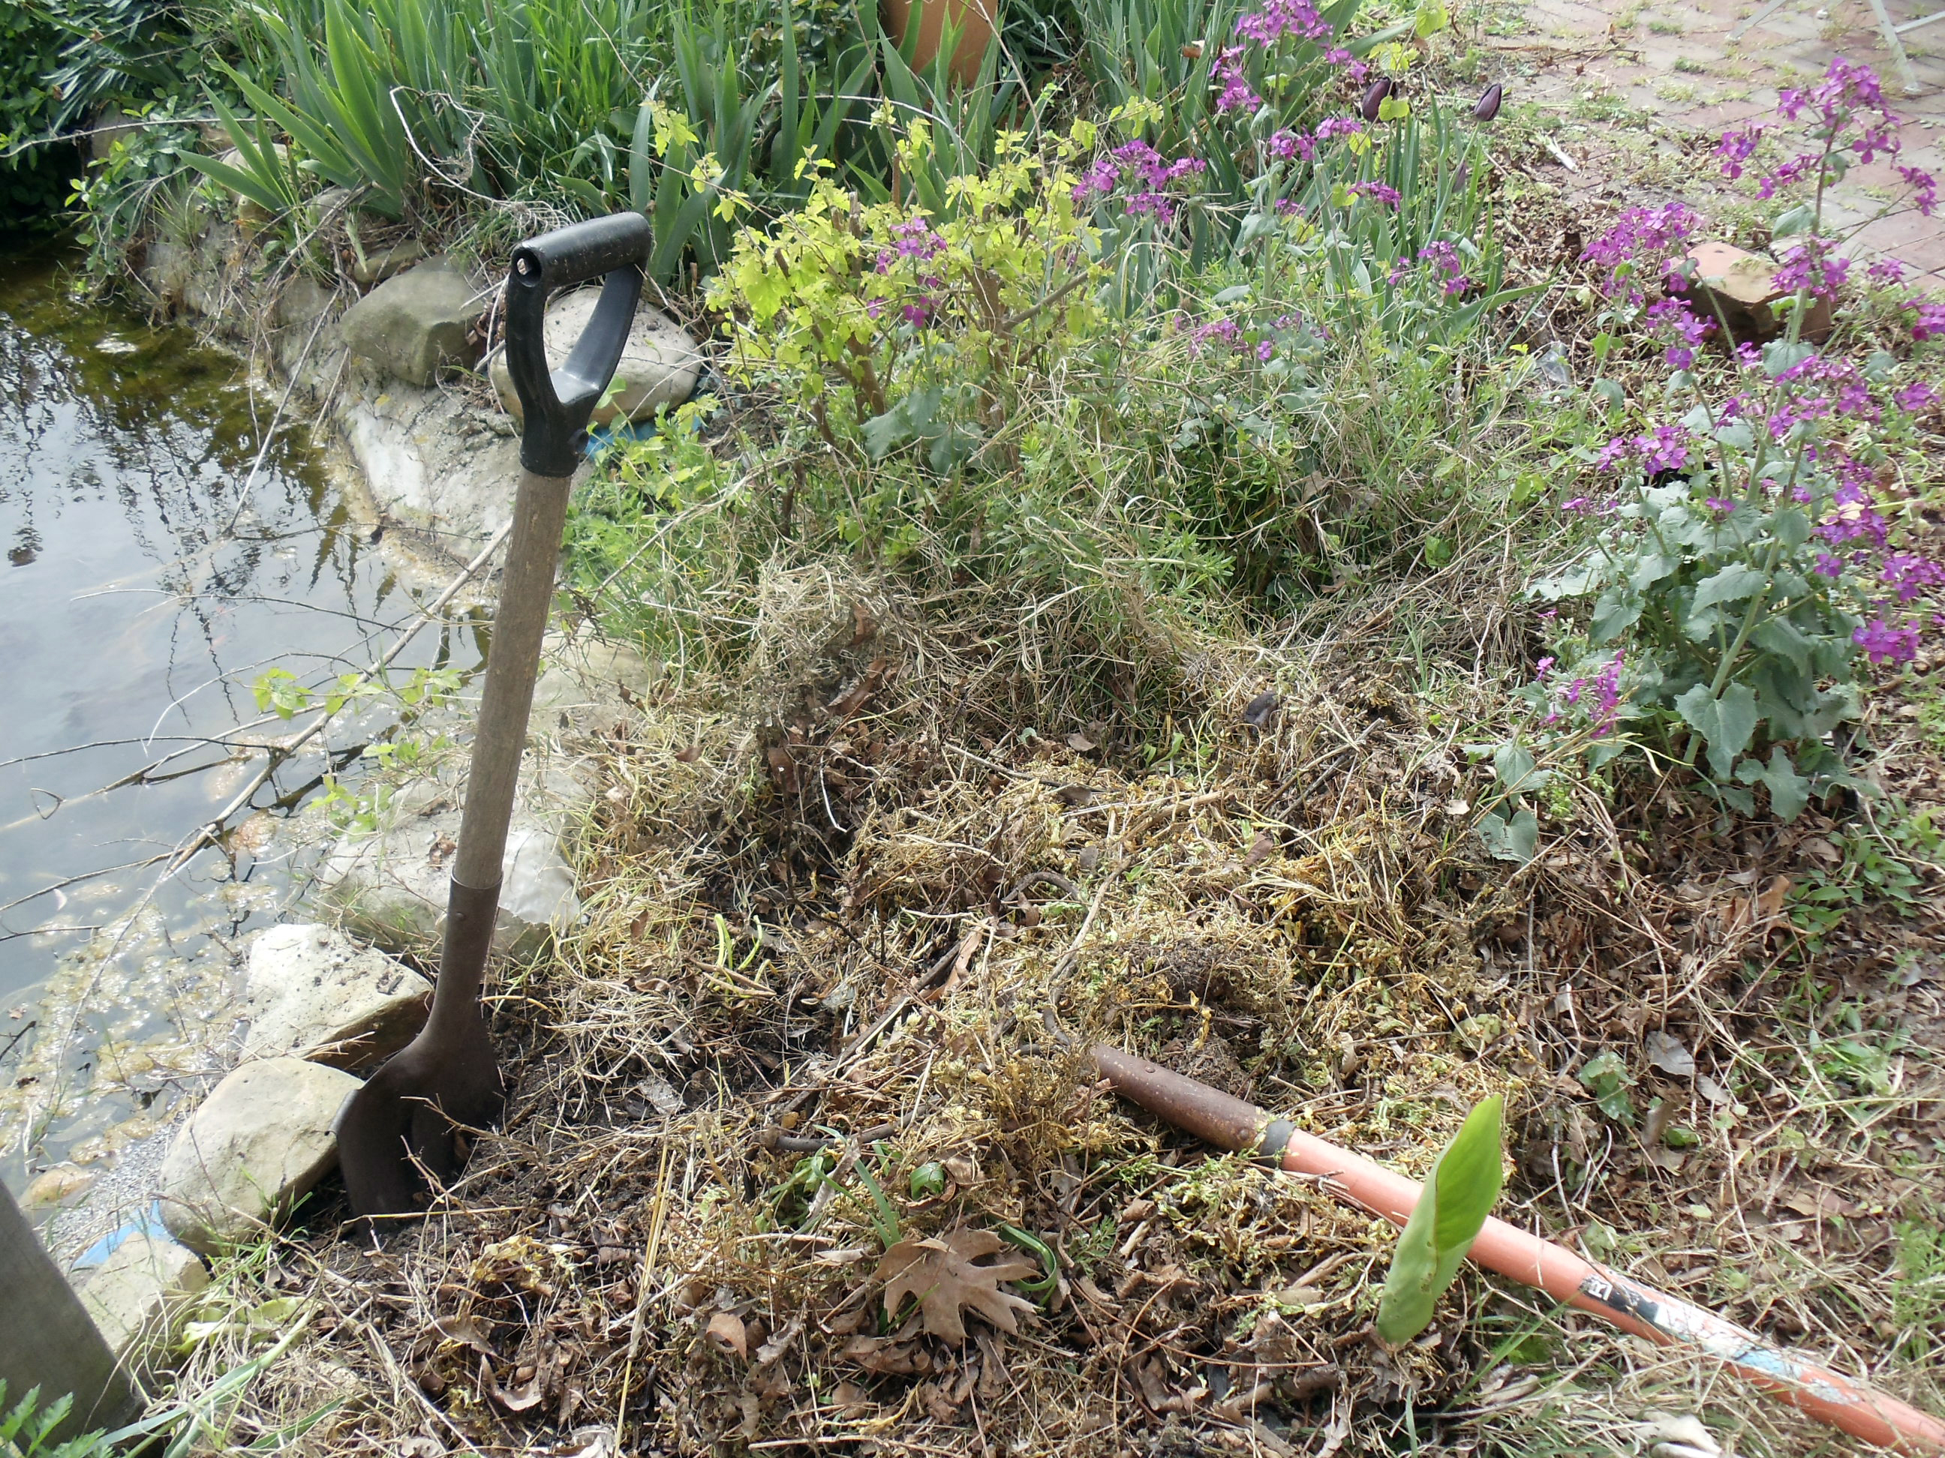
Working Outside the System
Turf management
Notes:
If allowed to enter the bio-retention ponding area these grass clippings will add excessive nutrients to the system and consume oxygen as they decompose.

Slide 18
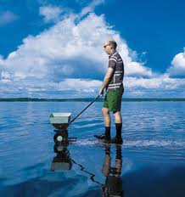
Working Outside the System
Turf management
Fertilizer and Herbicide Application
Notes:
With regard to fertilizer and herbicide:
--Timing is key– both are moved by water, so applying before a rainfall will cause both to be washed off with stormwater into the bio-retention systems.
--Both can have a negative impact on the system.
--If possible do not use these products around bio-retention systems at all. If you must use them, be sure to apply only the prescribed amount, which will quickly be absorbed by the targeted plants.
--Never use them within the system, unless you need to eliminate an invasive plant that has overrun the system and no other management technique is possible.

Slide 19
Tidying Up Around the System
Notes:
Ensure that none of the practices around the outside of the basin will impact its function. It is important NOT to brush or sweep any debris into the basin components, either through the entrance, planting bed or outlet.

Slide 20
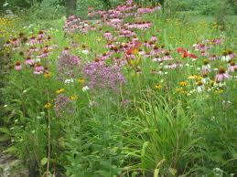
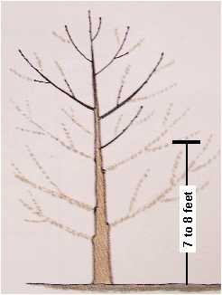
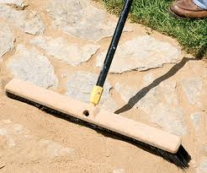
Maintaining for
Aesthetics vs. Functionality
Maintain the balance between tidying up and disturbing functionality
Naturalized garden setting:
Tall, disorganized and evolving
Within the garden, allow plants to grow in a natural form. Only change their form if causing issues outside the system.
Notes:
The cosmetic look of the system must be balanced with its functionality. The garden can be formal or naturalized – as long as the bio-retention function of the working landscape is not compromised.

Slide 21
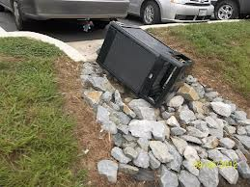
At the End of a Work Session
Ensure entrance is clear of debris, sediment or other material
Ensure no material/soil/plant debris is blocking the flow through the garden
All soil within the garden is level
Notes:
The same is true when completing your final inspection of the work. Again, the function of the system is paramount and nothing must impede its efficiency. Be sure that the water can flow, but that the ponding area is level. Generally, a carefully maintained bio-retention system will also be pleasing to the eye and a welcome addition to any landscape.

Slide 22
You Have Learned:
How the surrounding land areas can influence the structure and function of Green Infrastructure systems
What maintenance measures should be undertaken to ensure consistent functioning
Notes:
We hope that you have a better understanding of the maintenance steps that are necessary to keep a Green Stormwater Infrastructure system working.
In this presentation you learned:
How the surrounding land areas can influence the structure and function of Green Infrastructure systems
What maintenance measures should be undertaken to ensure consistent functioning

Slide 23
Notes:
This concludes this presentation on maintaining the landscapes that surround green infrastructure. Thank you to our funder – the US Environmental Protection Agency Region III, and partners PHS, AKRF, Inc. and GreenTreks Network, which helped produce this series.

