Slide 1
Spring and Summer Maintenance of Stormwater Management Practices
Prepared by: Emma Melvin, PHS
Barley Van Clief, PHS
Notes:
Welcome to this Green Infrastructure Maintenance Training. This presentation is one of several in the training series.
You can view the entire series sequentially, or each module independently.

Slide 2
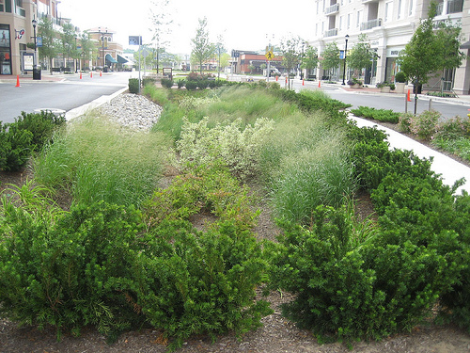
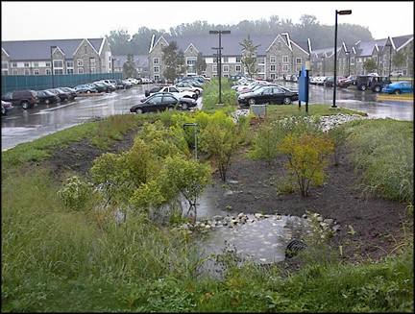
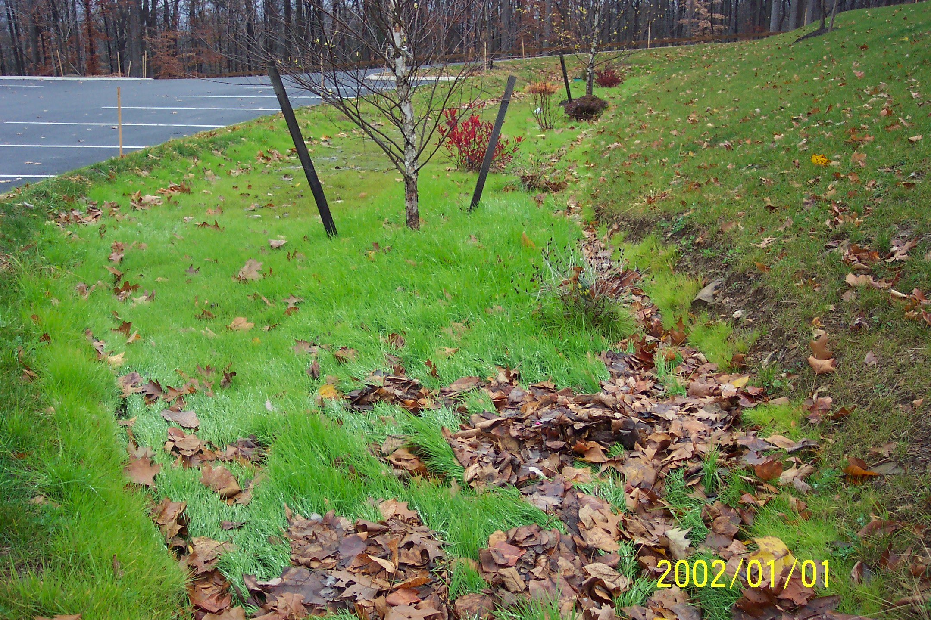
Overview
Why is it important to maintain Green Stormwater practices to keep the systems functioning
What maintenance issues can arise for each of the components in a stormwater management system
What specific steps can be taken to correct each of the maintenance issues
Notes:
The benefits of Green Stormwater Infrastructure can only be achieved if the systems are working properly through routine maintenance.
In this presentation you will learn:
Why it is important to maintain Green Stormwater practices to keep the systems functioning
What maintenance issues can arise for each of the components in a stormwater management system
The specific steps that can be taken to correct each of the maintenance issues

Slide 3
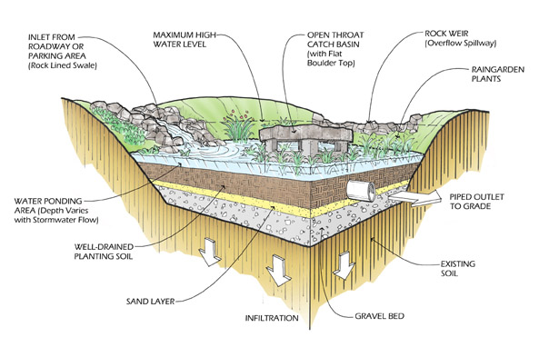
Bioretention Systems
Notes:
Bioretention systems are commonly called rain gardens - describing the most common form of bio-retention that includes one or more recessed planting beds that receive stormwater. Other practices include bio-swales, which are essentially densely planted ditches with a series of berms or check dams that hold and slowly move water along the swale to absorb and treat stormwater. Tree trenches are another form of bio-retention system, using trees as the main vegetation, with a sandy soil trench that extends from one tree pit to the next and gravel storage underneath – all designed to limit ponding at the surface.
This is a drawing of a bio-retention system or rain garden. All systems have 3 main components:
An inlet or entrance, where water enters the system. This can include any combination of storm drains, curb cuts or simple sheet flow of water into pipes, swales, or forebays.
A planting bed, which is a recessed planting area that detains water, allows materials in the water to settle out and helps water to absorb into the ground. The powerhouses of the rain garden are the porous soil and plants growing in the planting bed. There may also be underdrains beneath the soil medium.
Water leaves the system through the outlet or exit when the level exceeds the designed ponding depth. There are typically two outlets: an in-bed outlet made up of a riser pipe and cover and an overflow spillway, which is a depressed area in the berm or top edge of the system that directs water out of the system to a designated area.

Slide 4
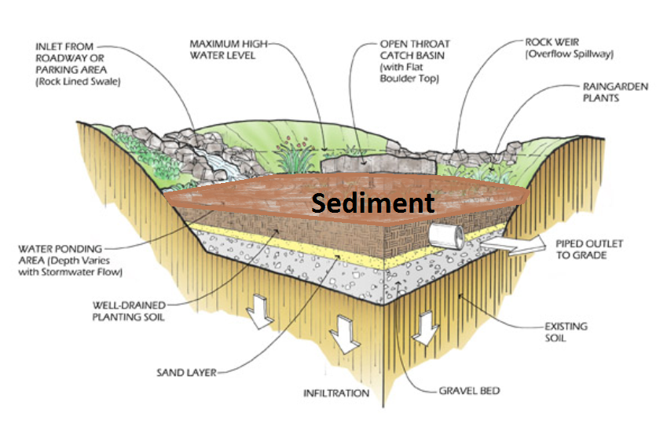
Bioretention Systems
Notes:
Stormwater carries with it all the things it picks up along its journey to the system including sediment created from eroded soil particles. When systems are not maintained or are overwhelmed by the excess material, this build up may bury the plants, clog the soil pores and obstruct the entrance and exit of the system, causing it to no longer function.

Slide 5
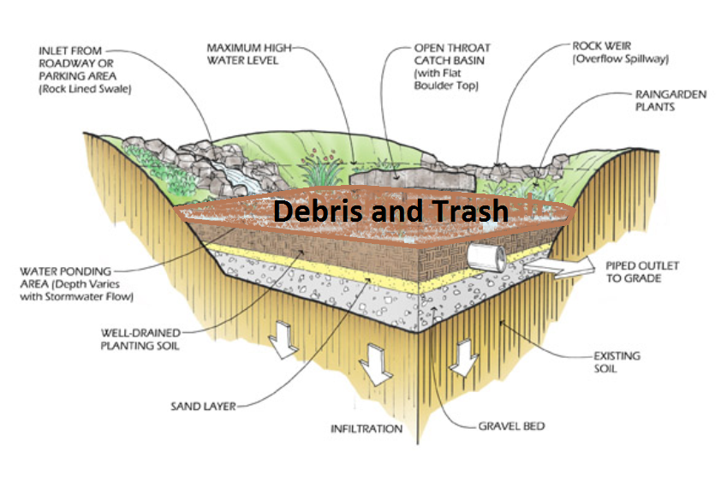
Bioretention Systems
Notes:
Stormwater can also carry debris and trash that it has picked up along its journey to the system.

Slide 6
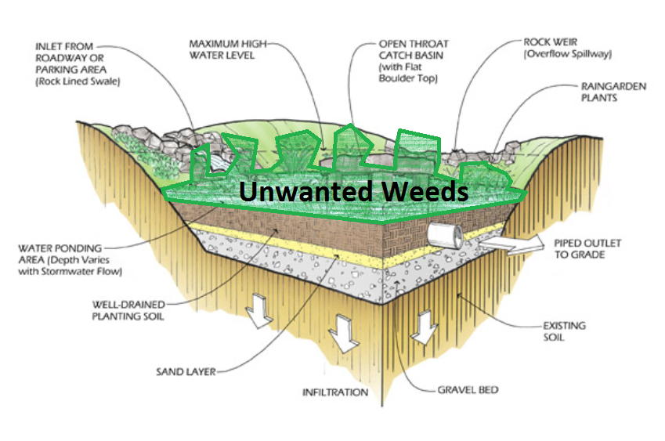
Bioretention Systems
Notes:
In addition, weed seeds and unwanted plants can enter the system and may crowd out the other plants originally planted.

Slide 7
Maintenance on Entrances/Inlets
Problems: | Solutions :
Erosion | Add stones at the top of the entrance
Sedimentation/clogging | Create a forebay at the bottom of the entrance Clear sediment or debris from pipes, culverts and swales at every visit
Gullying | Dense planting or additional stone
Water bypassing entrance | Clear entrance of sediment, grass or debris
Notes:
Each component of the system will have unique maintenance issues. When maintaining a site, always check the inlets and outlets before you start work within the planting bed. Ensure that water is able to enter the bio-retention system unobstructed. Clogging at the entrance of the inlet with sediment, leaf litter, or trash will cause water to bypass the system and cause erosion around the inlet.
If water enters an open swale too quickly, or if part of the entrance is clogged, erosion can occur, causing gullies to form and plants to die in a soft-surface swale or in the planting bed of a hard surface swale.

Slide 8
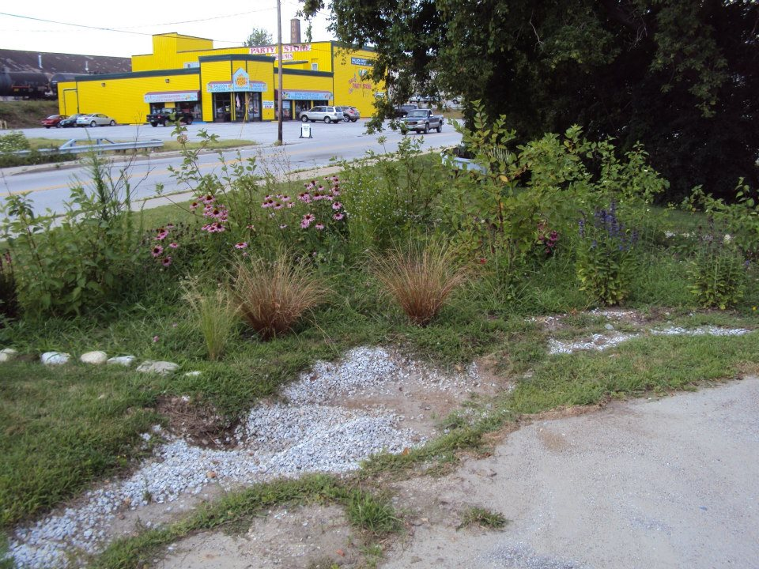
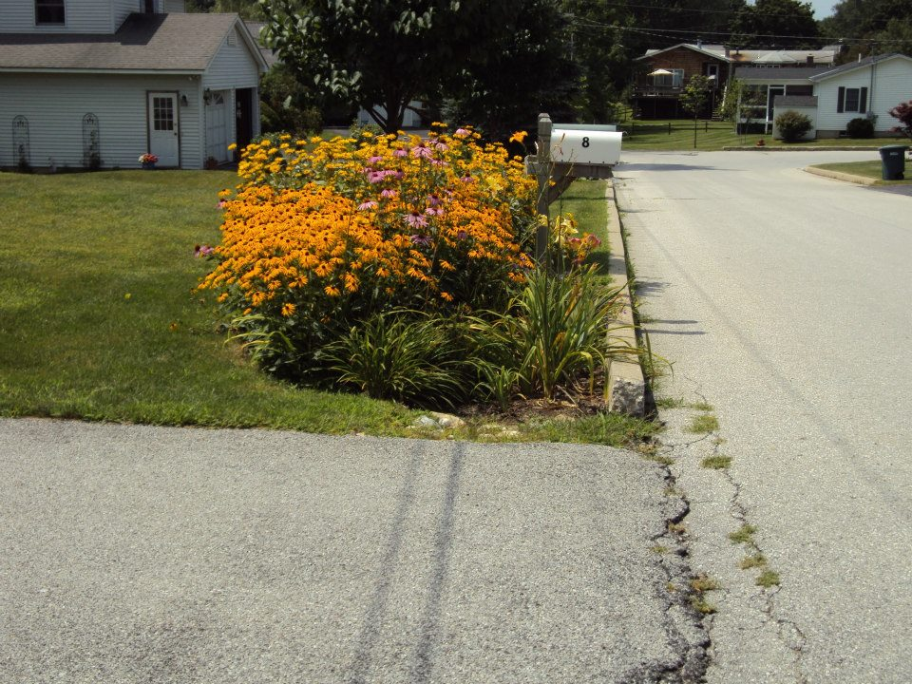
Clogged Entrance
Grass blocking entrance
Sediment and grass blocking the flow into the garden
Notes:
As stormwater enters these systems through the inlet, it slows down and drops the materials it was carrying. This can include road gravel, soil, and seeds.
Floatable items like bottles and other trash usually stay in suspension until the water enters the planting bed and starts to drain.

Slide 9
Clogged Entrance
Grass blocking entrance
Notes:
Sediment can cause the entrance to be clogged or blocked, preventing the stormwater from entering the system. In this case, grass has grown on the deposited sediment.

Slide 10
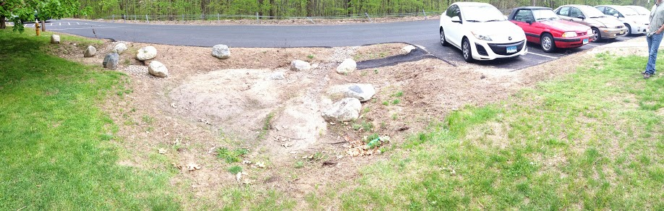
Sediment Flows in with Water
Sediment in the garden/
Plant die-back
Notes:
Sediment can also drop out within the inlet and planting bed. It can smother the plants within a vegetated swale, can block the water from entering the system or can cause erosion at the top of the planting bed. If the sediment entering the garden is repeatedly smothering the vegetation of the planting bed, or if the system is installed in a high sediment area, a forbay can be installed at the end of the inlet, with a small ponding area and a low check dam. This allows easy sediment removal and cleaning compared to the task of removing sediment from the planting bed.

Slide 11
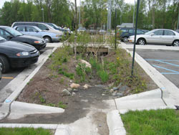
Sediment Flows in with Water
Sediment entering the garden
Sediment in the forebay
Notes:
Sediment can also drop out within the inlet and planting bed. It can smother the plants within a vegetated swale, can block the water from entering the system or can cause erosion at the top of the planting bed. If the sediment entering the garden is repeatedly smothering the vegetation of the planting bed, or if the system is installed in a high sediment area, a forebay can be installed at the end of the inlet, with a small ponding area and a low check dam. This allows for easy sediment removal and cleaning compared to the task of removing sediment from the entire planting bed.

Slide 12
Maintenance on Exit/Outlets
Problems: | Solutions :
Erosion | Add stones around the outlet inside the bed and at the bottom of exit for the overflow
Clogging | Clear sediment or debris from rise pipe grate and swales at every visit
Gullying | Dense planting or additional stone
Notes:
Maintenance issues that can arise with outlets include the same issues are the inlets. They can become clogged with sediment, leaf litter and trash. Water can get stuck inside the system causing soil saturation in the planting bed. Clogging can also lead to erosion around the outlet structure. Both of these situations can lead to plant die-back. During all storms, the flowing water can move mulch around the planting bed. In large storms, mulch can be carried completely out of the planting bed.

Slide 13
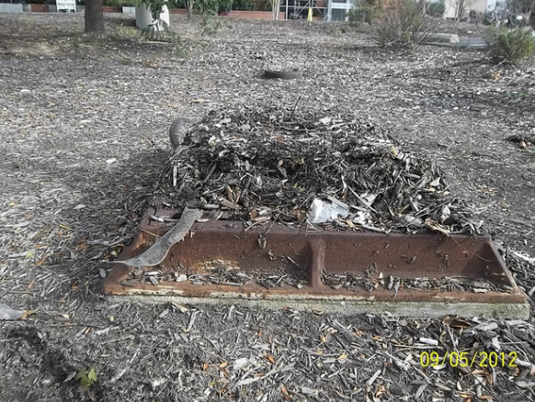
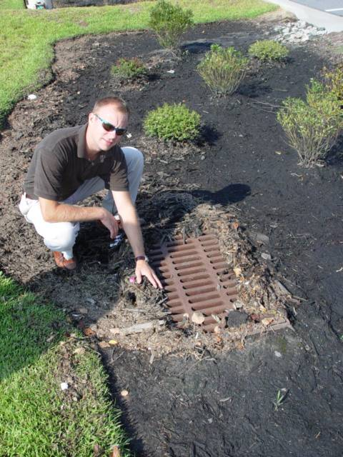
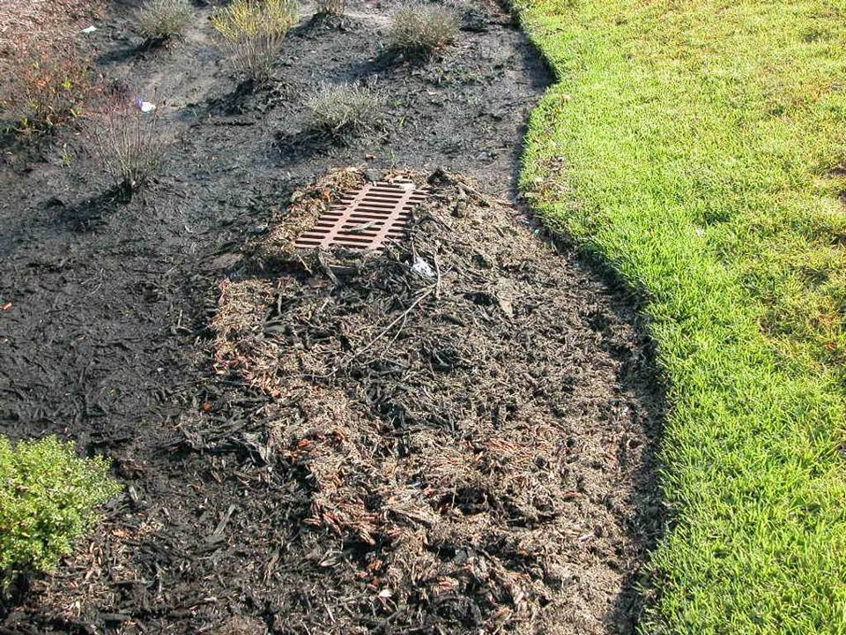
Removing Debris from Outlet
Notes:
As stormwater enters the planting bed it will drop out sediment, but it will also pick up and move floatables, including mulch. Water will push mulch with it as it reaches the outlet/exit. As the water ponds and drains into the soil and overflows into the outlet, the floatables and other materials it is carrying will drop out and pile up near the top of the outlet.

Slide 14
Removing Debris from Outlet
Notes:
The debris must be removed and mulch redistributed as a routine maintenance task.

Slide 15
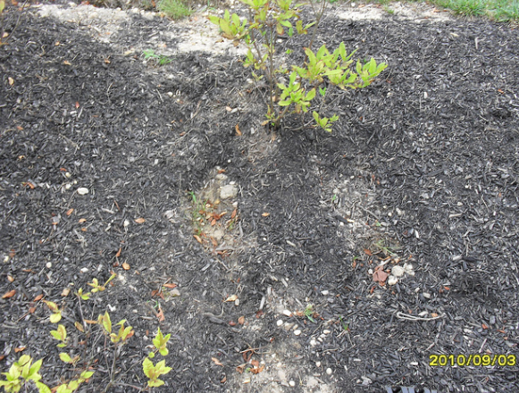
Mulch in the Garden
Mulch shifted out of place
Notes:
During a large storm, mulch can be shifted out of the planting bed as the water leaves the system, washed off the sloped areas in the planting bed, or it can be washed out of the system and need to be totally replaced.

Slide 16
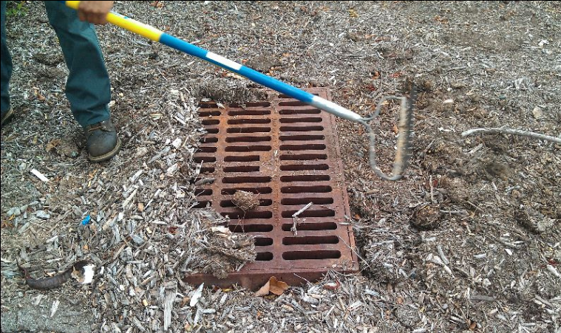
Removing Debris from Outlet
Notes:
It is important that the maintenance routine includes the replacing of shifted mulch back throughout the planting bed and adding mulch only when necessary. Mulch protects the soil from excessive drying out and actually helps to remove pollution from the stormwater.

Slide 17
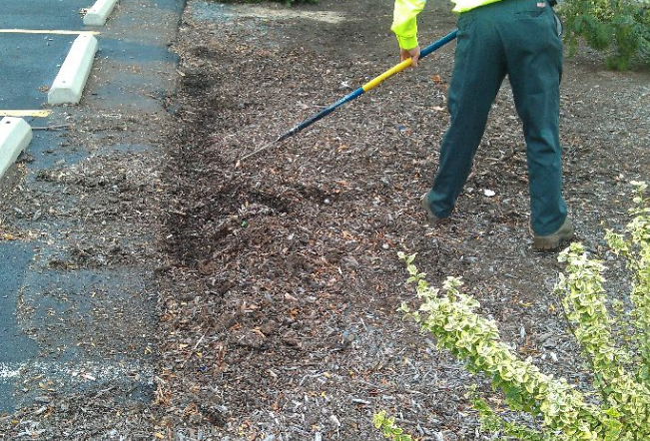
Mulch in the Garden
Raking mulch back into place
Notes:
But adding mulch at every visit will cause a build up of mulch in the planting bed, which can smother plants under the mulch. It can also eventually fill up the recessed planting bed, leading to a reduced ponding area.

Slide 18
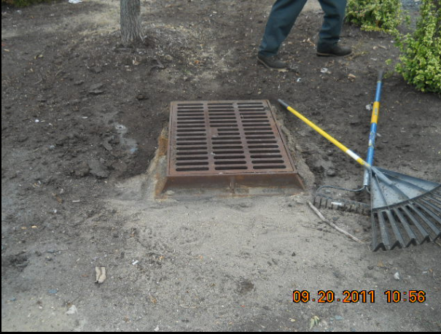
Erosion
Sedimentation caused by erosion
Notes:
As the water enters the planting bed from the entrance or exits the planting bed, it can erode exposed soil. Rocks can be added to the bottom of the entrance or exit into the planting bed to disperse the water at a level portion of the bed.

Slide 19
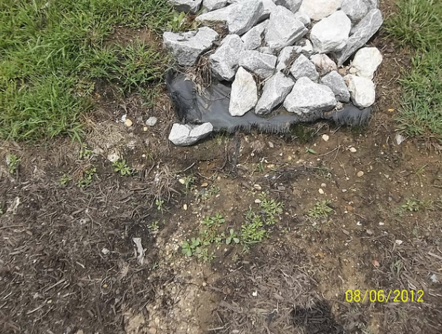
Erosion
Erosion gully starting to form
Notes:
Gullies can form if the rocks do not cover the entire area that is susceptible to erosion.

Slide 20
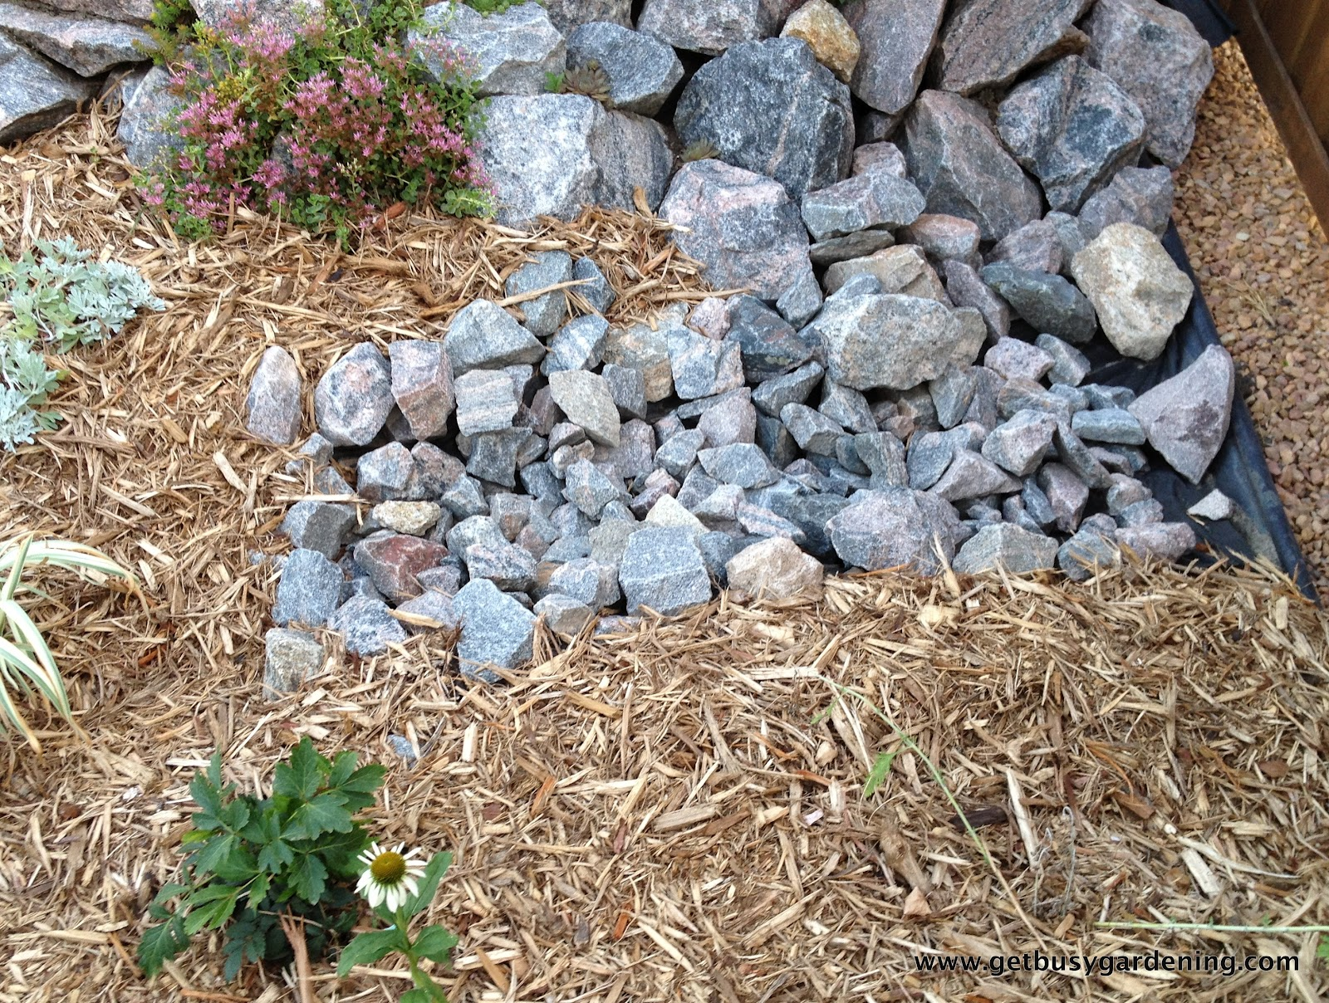
Stone Around Entrance and Exit
Notes:
As water enters the system, large rocks should be placed at the top of the entrance and along the sides of a open swale to disperse and slow stormwater and capture sediment. Smaller rocks can be extended into the swale to direct water and protect against gullying. Similar rock formations can be created at the outlet of the system - around a culvert or storm drain within the planting bed.

Slide 21
Maintenance Within Planting Beds
Problems: | Solutions :
Erosion | Add stones at the bottom of the entrance and around the outlet
Sedimentation/clogging | Create a forebay at the bottom of the entrance. Clear sediment or debris from pipes, culverts and swales
Gullying | Create check dams to slow water
Too much water entering the system | Create berm around planting bed and swale to limit the water entering the system
Plant die back | Clear debris from outlet to ensure water is not getting stuck in planting bed and then replace plants
Notes:
It is important to assess the movement of water through the system, including how it enters the planting bed, how long it ponds within the planting bed and how it exits the planting bed.
These systems are designed to drain quickly after a normal storm , with standing water for no more than a day or two at longest.
If ponding lasts longer than this, it will lead to changes in soil biology and soil porosity. When soils are saturated with water for long periods of time, the soil microbes that live in the well-drained soils of an oxygenated soil environment will die and will be replaced by microbes that live in anoxic or anaerobic conditions, that is, without oxygen, such as is common in a wetland system.
Too much water or sediment entering the system can be the cause of ponding water. Soil compaction can be another cause of ponding water, this can have occurred at installation, during maintenance or due to long periods of ponding water. All these issues will lead to plant die back that can also lead to soil erosion and gullying.

Slide 22
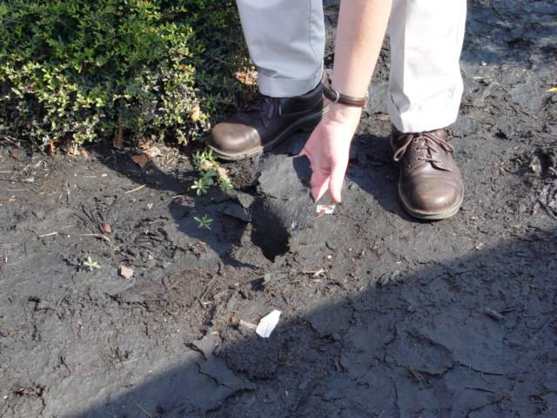
Sediment Caked on Planting Bed
Notes:
Stormwater can carry in excessive sediment that does not get integrated into the soil but smothers the mulch and cakes over into an impenetrable layer that water can not pass through. If not broken up or removed, plants will die and soil will become compacted with the pressure of standing water.

Slide 23
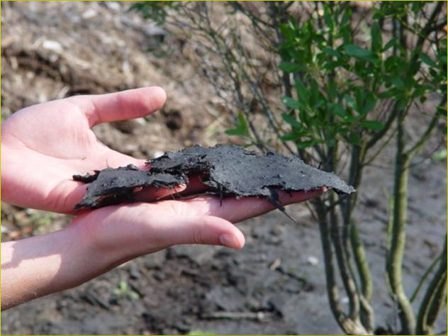
Matted Mulch & Sediment Removal
Notes:
Maintenance would include scraping off the excessive sediment, breaking up the caked, matted mulch, and turning the mulch. If mulch is unsalvageable, it should be removed and replaced.

Slide 24
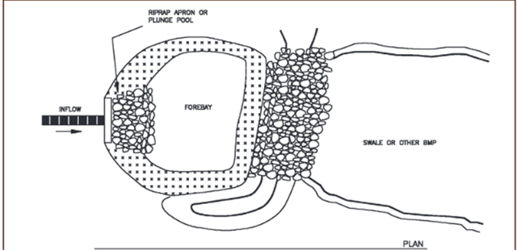
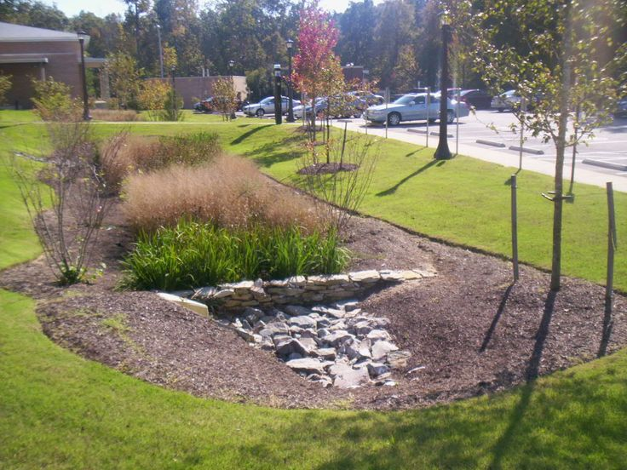
Adding a Forebay for Sedimentation
Forebay
Notes:
If sediment is an issue inside the garden, causing dead zones and clogging and requiring constant extensive maintenance, a forebay can be added to the bottom of the entrance inlet. Stormwater that is exiting the inlet will pond there and allow the sediment to drop out of the water prior to entering the planting bed. This forebay can be cleared seasonally to remove accumulated sediment without disturbing the plant material in the planting bed.

Slide 25
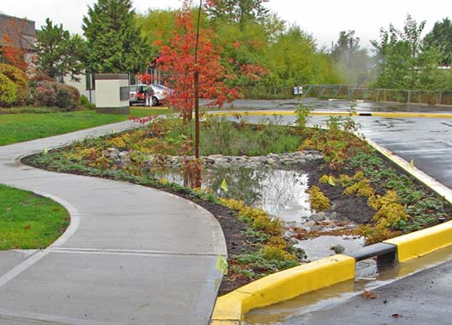
Creating a Check Dam
Notes:
If stormwater enters the system at high rates, check dams can be added to the entrance and the planting bed to slow the flow of water as it passes through the system. Check dams can also be added if the planting bed becomes sloped causing limited ponding throughout the planting bed. The check dam will create additional ponding areas.

Slide 26
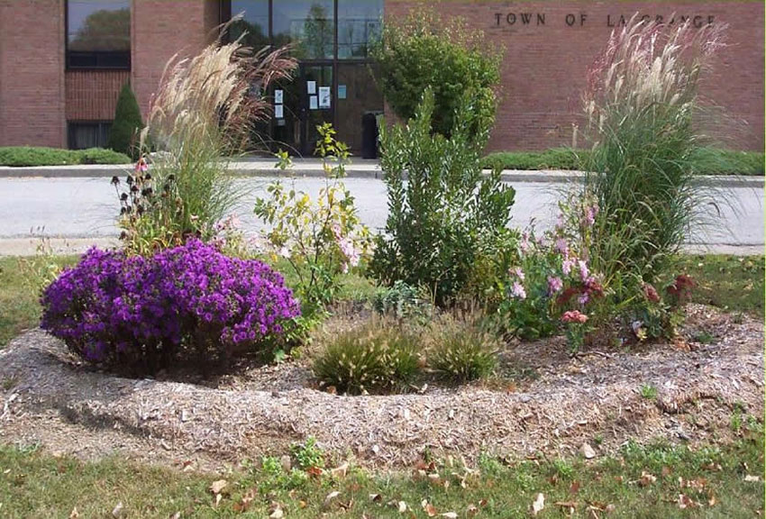
Creating a Berm
Notes:
A berm is just a mounded area surrounding the bio-retention system partially or completely. It can be made of compacted soil, rocks, logs or any other material that will hold water in the system. Berms can also be installed to direct water either into or away from the planting bed, helping to regulate the volume of water in the planting bed.

Slide 27
You Have Learned:
Why is it important to maintain Green Stormwater practices to keep the systems functioning
What maintenance issues can arise for each of the components in a stormwater management system
What specific steps can be taken to correct each of the maintenance issues
Notes:
We hope you have a better understanding of the importance of keeping Green Stormwater Practices well-maintained. You have learned:
Why it is important to maintain Green Stormwater practices to keep the systems functioning
What maintenance issues can arise for each of the components in a stormwater management system
The specific steps that can be taken to correct each of the maintenance issues

Slide 28

Notes:
This concludes this presentation on maintaining stormwater management practices for green infrastructure. Thank you to our funder – the US Environmental Protection Agency Region III, and partners PHS, AKRF, Inc. and GreenTreks Network, which helped produce this series.

